Slide 1

Accelerate AR Remote Deposit Capture
Installation Procedures: Windows
Notes:
Hello and congratulations on your new Accelerate AR RDC service! This video includes the steps to perform a self-upgrade for existing Commercial Capture Xpress and Remote Express Deposit clients to the Accelerate AR RDC service.

Slide 2
Installation Checklist
Welcome to the installation phase of your Accelerate AR RDC services with Synovus! To ensure a smooth and successful setup, please follow the checklist below:
Verify administrative permissions. You, or your company’s representative(s) must have administrative permissions on your computer to install/update software. Please verify your administrative permissions and ensure your passwords are current.
Synovus Gateway user access will be required. To access the Accelerate AR RDC service you must be permissioned access within the Gateway portal.
Ensure Compatible Hardware. To utilize RDC services with Synovus you must have a compatible check scanner. You may bring your own compatible scanner or order a new scanner.
Install Ink Cartridge. If you are utilizing a check scanner with an ink cartridge, ensure this is installed prior to installation.
Remove Legacy Scanner Hardware. If you are moving RDC services from another financial institution You, or your company’s representative(s) will need to ensure any legacy bank software has been removed prior to installing services with Synovus.
Prepare for a Test Deposit. To ensure true end to end installation is successful, it is preferred to perform a test deposit at time of installation. Please have a check handy to scan.

Slide 3
Installing Accelerate AR RDC
Notes:
Moving into installation

Slide 4
Installing WebScan
WebScan is a software component used to facilitate the scanning and processing of checks via web browsers. It allows RDC scanners to operate seamlessly with browsers like Microsoft Edge, Mozilla Firefox, and Google Chrome.
Note: WebScan only has to be installed once per PC regardless of how many users are utilizing that device.
Login to Gateway Within the Accelerate Solutions drop down select Accelerate AR RDC. Within the AR RDC application select the Help Menu. From within the Help Menu select Download WebScan. WebScan download will initialize. Open the download from your browser or file explorer. | 7. Run as Administrator. 8. WebScan Setup Wizard will display and take you through the steps for Installation. Select Next to continue through installation. 9. WebScan has been successfully installed. Click Close. 10. After a successful installation you should see the WebScan icon within your system tray and on your desktop. It will be blue in an idle status and green when initialized.

Slide 5

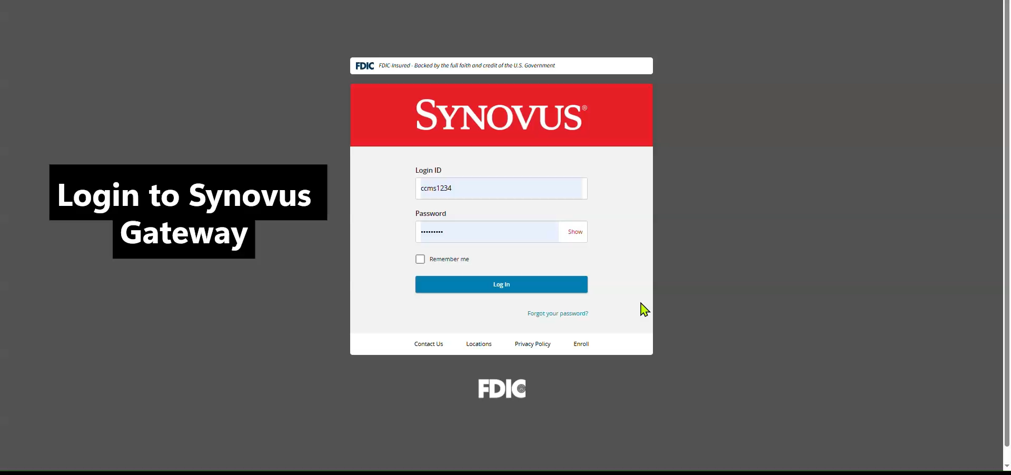
Installing WebScan
Click Play for Video

Slide 6
Installing Scanner Drivers
Now that we’ve installed WebScan, we will need to install your associated Scanner Drivers to process deposits via Accelerate AR RDC.
Note: If you do not see your scanner model listed under the help menu, contact your support team directly to have added.
Ensure your scanner is unplugged at this time. Within the AR RDC application select the Help Menu. From within the Help Menu select Download Scanner Drivers. Select your associated scanner model to begin the download process. Open the download from your browser or file explorer. | 6. Run as Administrator. 7. The Driver Setup Wizard will display and take you through the steps for Installation. Select Next to continue through installation. 8. Drivers have been successfully installed. Click Finish. 9. At this time, you can plug in your scanner and perform a system restart.

Slide 7
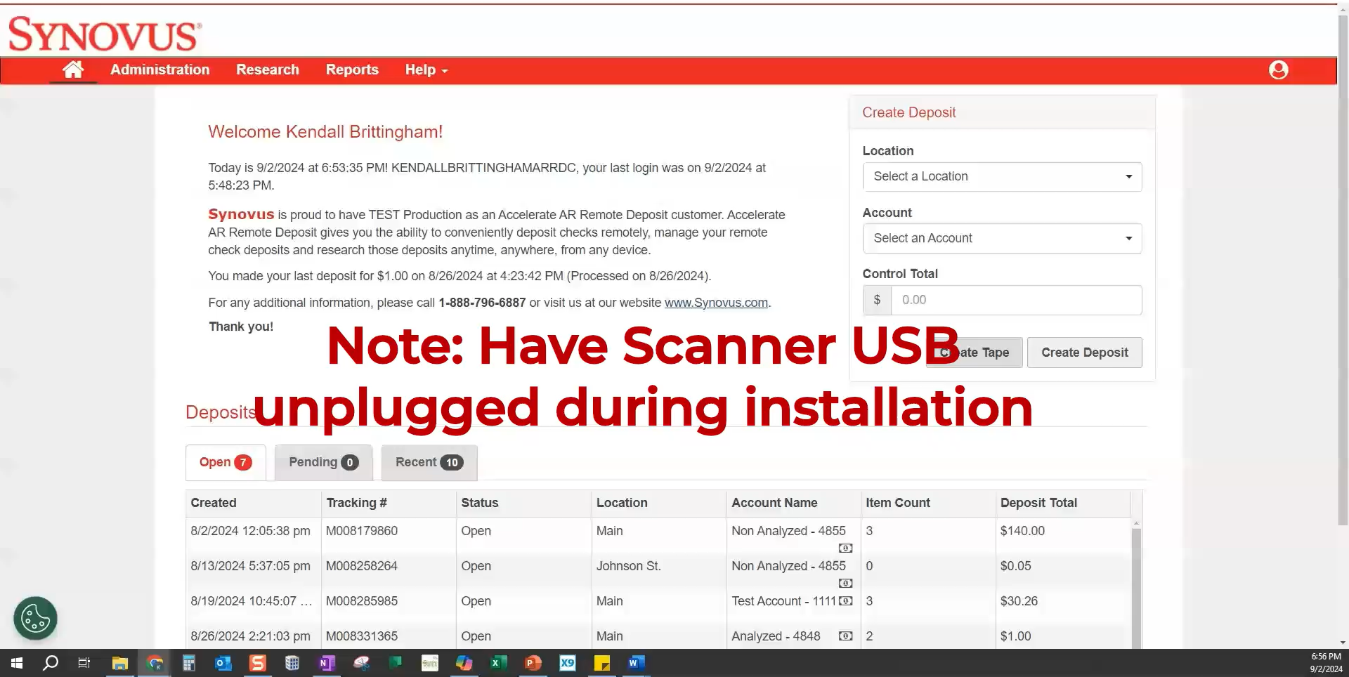
Installing Scanner Drivers
Click Play for Video

Slide 8
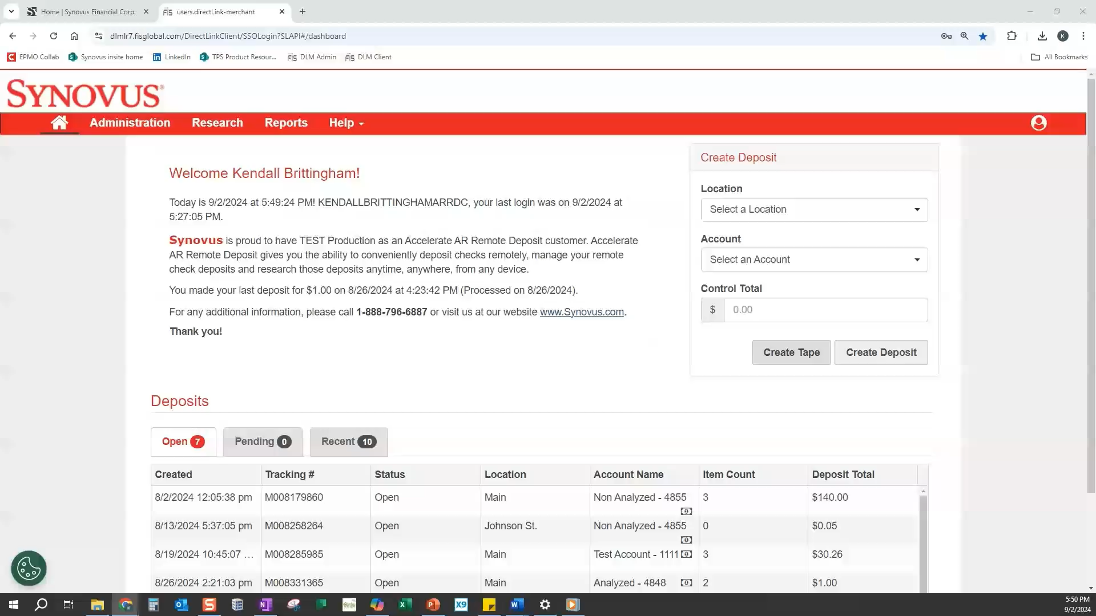
Assigning Scanner Type to Your Profile
Click Play for Video
To establish connectivity between WebScan and your Scanner Drivers we must ensure your appropriate scanner type is assigned to your profile.
Note: This step is critical - if you do not assign your scanner type at your user profile level you will experience a connectivity issue when attempting to initialize scanner.
Notes:
Lastly, now that we’ve installed all our software we need to assign our scanner type to our user profile. This step is critical and if unassigned will cause communication errors between WebScan and your Scanner. Watch this short clip for instructions.

Slide 9
Common Installation Troubleshooting Tips
If you experience any issues during the installation process, below are some common troubleshooting steps for resolving some common issues:
“Device Library Failed to Load”
  Ensure your scanner type is assigned at the user profile level
  Ensure your ink cartridge is properly seated
  If you are utilizing and ink jet scanner with no ink cartridge assign your scanner type to “Digital Check No-Print” at your user profile level
  Perform a restart
Scanner Stuck in “Initializing”
  Ensure your scanner USB is plugged directly into your USB port
  Ensure any legacy software (if applicable) removed from Device – check C drive for lingering files
  Perform a restart
“Error Occurred While Initializing WebScan Hub”
  WebScan may not be running. Check the system tray for the WebScan Icon. The WebScan icon will be blue when on and idle and green when initialized.

Slide 10
Using Accelerate
AR RDC
Notes:
Moving into installation

Slide 11
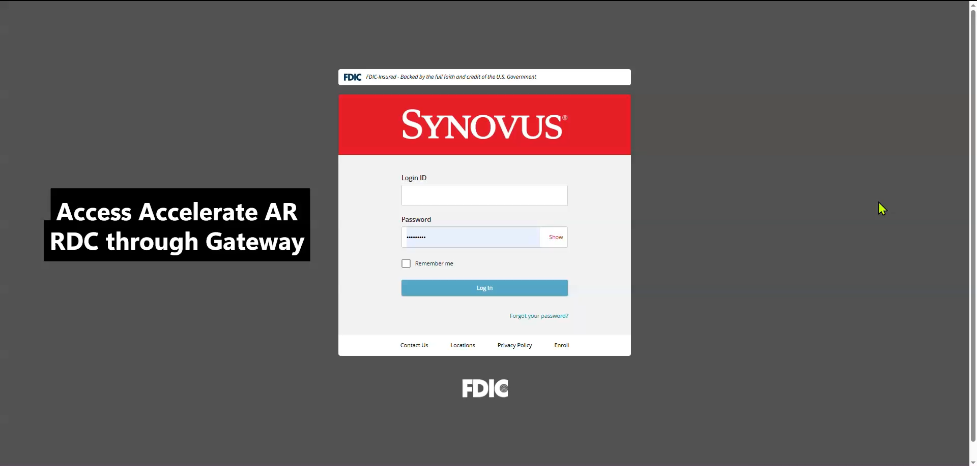
Using Accelerate AR RDC
Click Play for Demo
Congratulations! You’ve successfully installed your Remote Deposit Software and can now begin processing deposits with Accelerate AR RDC.

Slide 12
Questions
?
Contact Your Treasury Management Onboarding Team
or Customer Care Specialists are available for assistance:
Monday through Friday
8 am – 6 pm EST: (888) 796-6887 option Treasury
Notes:
Thank you for watching our Accelerate AR RDC Self Upgrade instructional video, if at any point you need any assistance with your upgrade or have questions about our new solution please feel free to reach out to our Migration Support specialists who are available Monday – Friday from 10 am – 6 pm EST via phone or email via the resources provided on this screen.
Thank you for banking with Synovus and we hope you enjoy your new Accelerate AR RDC services!

