Slide 1

Accelerate AR Remote Deposit Capture
Installation Procedures: Mi:Deal on MAC

Slide 2
Installation Checklist
Welcome to the installation phase of your Accelerate AR RDC services with Synovus! To ensure a smooth and successful setup, please follow the checklist below:
Verify administrative permissions. You, or your company’s representative(s) must have administrative permissions on your computer to install/update software. Please verify your administrative permissions and ensure your passwords are current.
Synovus Gateway user access will be required. To access the Accelerate AR RDC service you must be permissioned access within the Gateway portal.
Ensure Compatible Hardware. To utilize RDC services with Synovus you must have a compatible check scanner. You may bring your own compatible scanner or order a new scanner.
Install Ink Cartridge. If you are utilizing a check scanner with an ink cartridge, ensure this is installed prior to installation.
Remove Legacy Scanner Hardware. If you are moving RDC services from another financial institution You, or your company’s representative(s) will need to ensure any legacy bank software has been removed prior to installing services with Synovus.
Prepare for a Test Deposit. To ensure true end to end installation is successful, it is preferred to perform a test deposit at time of installation. Please have a check handy to scan.

Slide 3
Installing Accelerate AR RDC

Slide 4
Installing Panini Mi:Deal on MAC
Follow the steps listed below to download the Network Certificate and configure your Panini Mi:Deal scanner for use with Accelerate AR RDC on MAC.
Ensure your scanner is plugged in and powered on at this time. Open System Settings navigate to Network. Verify connection to Mi:Deal is listed. Select the Mi:Deal Connection. Obtain the DNS Server address. Open a web browser and paste the DNS Server Address to access the Panini Configuration Page. Within the Panini Configuration Page, you can adjust configurations, update scanner firmware, or check the status of the device. | 8. Select Configuration. Select Connection Parameters Setup. Default setting for USB connection is RNDIS select Next. Scroll down to HTTPS section and ensure Default Certificate is selected from the drop down. Select Root CA Certificate Download (X509 DER Format). Continue to next slide for additional steps

Slide 5
Installing Panini Mi:Deal on MAC Continued
Clicking on the link will download the certificate. Access the download from your system tray or within your downloads. Open Keychain Access. The certificate will be displayed as “untrusted”. Right click on the Panini Certification Authority certificate and select Get Info. The certificate window will appear. Click the drop-down arrow next to Trust. In the When Using This Certificate dropdown select Always Trust. | 18. The certificate should now show in Keychain as being trusted. 19. Sign into Gateway and access Accelerate AR RDC. 20. Within AR RDC select the profile icon and user profile. 21. Under the Scanner Drop Down select Panini Mi:Deal. 22. A Scanner Host field will populate, enter the scanner DNS Server located during step 5 in network settings.
Note: Throughout this process you may be prompted to enter your password. Do so as applicable. Upon completion of the process, best practice is to perform a system restart and perform a test scan.

Slide 6

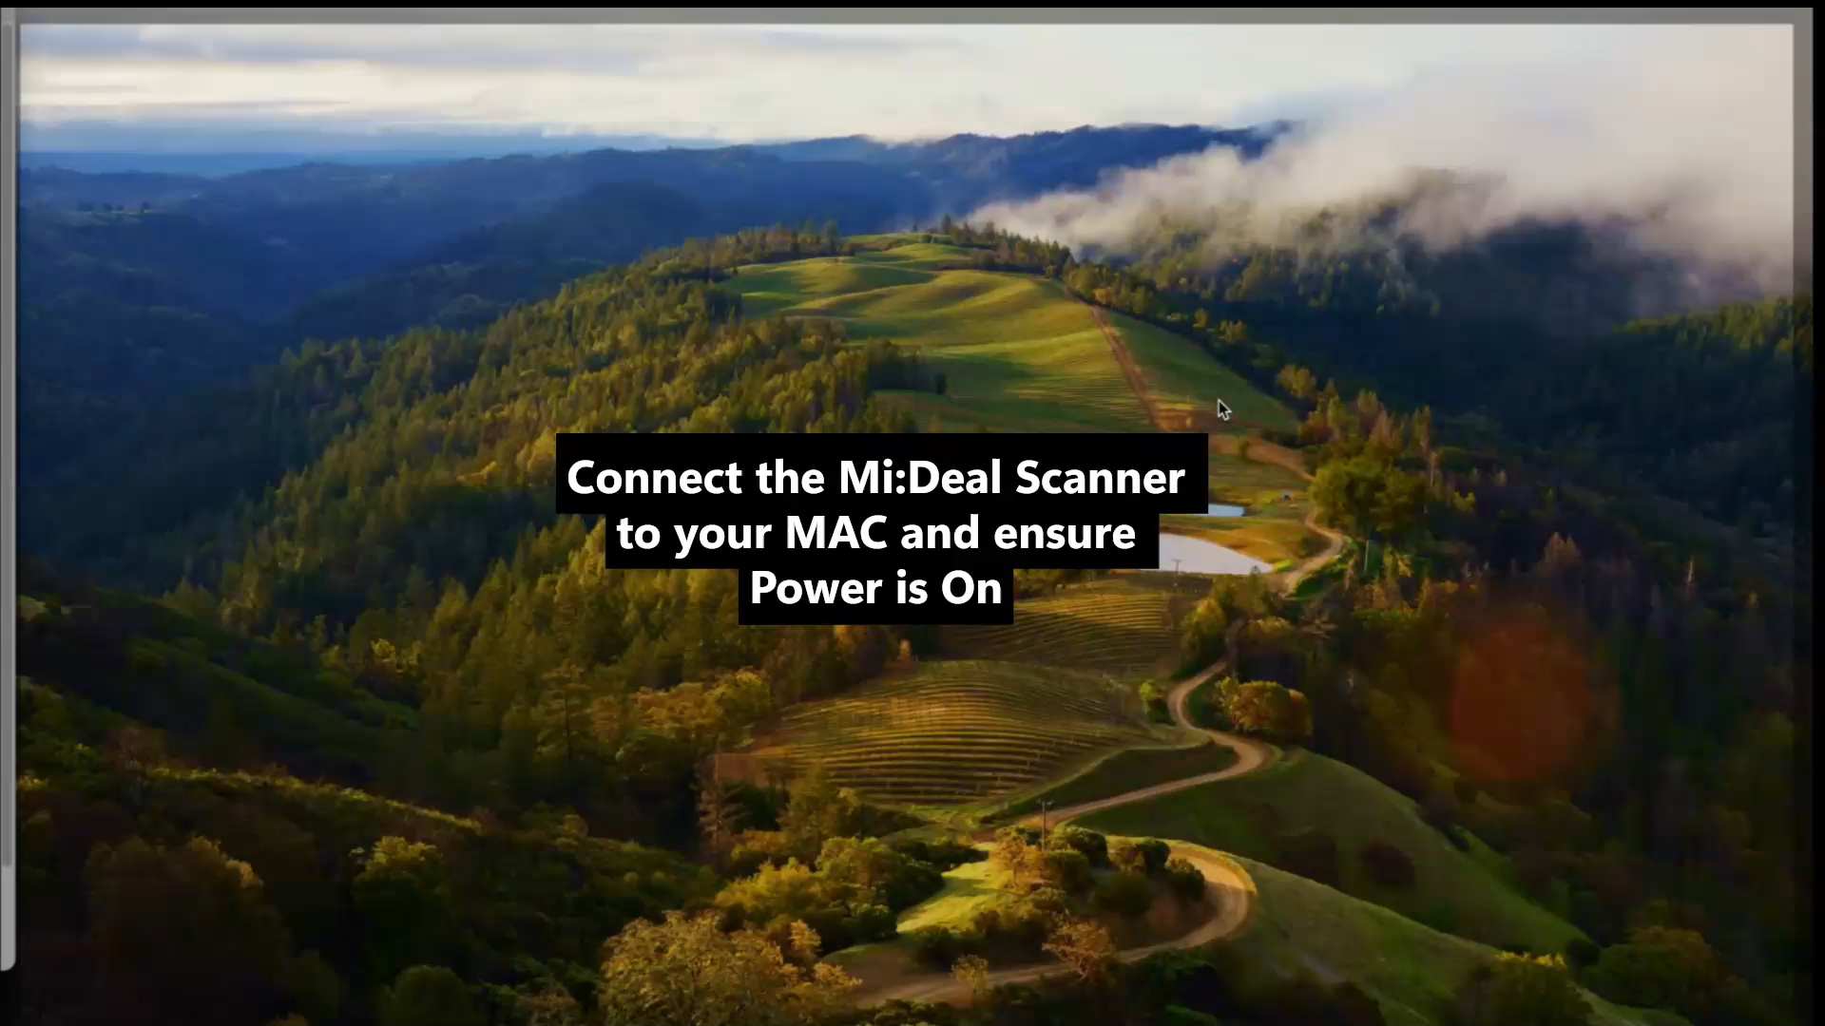
Installing Panini Certificate Demo
Click Play for Demo

Slide 7
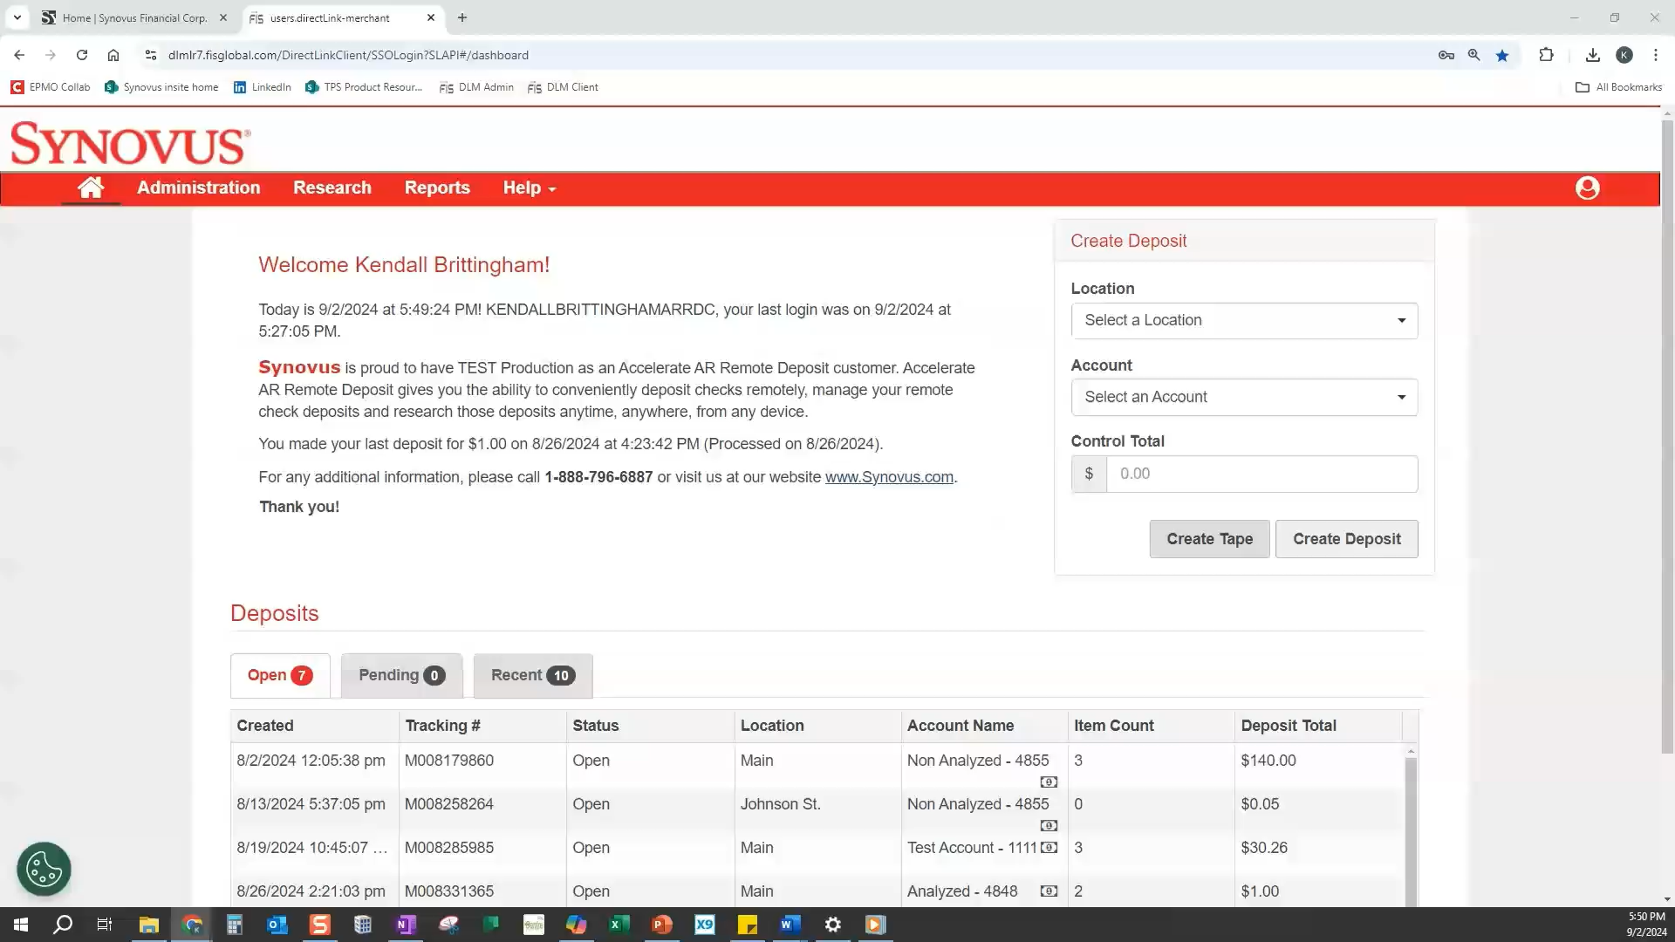
Assigning Scanner Type to Your Profile
Click Play for Demo
To establish connectivity between WebScan and your Scanner Drivers we must ensure your appropriate scanner type is assigned to your profile.
Note: This step is critical - if you do not assign your scanner type at your user profile level you will experience a connectivity issue when attempting to initialize scanner.

Slide 8
Common Installation Troubleshooting Tips
If you experience any issues during the installation process, below are some common troubleshooting steps for resolving some common issues:
Scanner Not Detected
Check all connections to device and PC.
Plug directly into PC not via an adapter
Try an alternate port
If these steps do not resolve attempt a factory reset depicted below
Factory Default Reset – sometimes a connection with the scanner cannot be made and the scanner must be started in factory default mode.
Unplug all cables from the scanner
Use a paperclip or similar object to insert into the bottom covered reset hole
Open top flaps of scanner and leave them open for the rest of the process
Plug USB cable into the scanner
Hold down the factory reset button for the remaining steps
Plug in power cable
Wait until scanner has completed reboot sequence. The LED light should start flashing tallow, and eventually alternating between flashing yellow and red. After the flashing stops the LED light stays yellow, release the reset switch.
Attempt to connect to scanner again.

Slide 9
Using Accelerate AR RDC
Notes:
Moving into installation

Slide 10
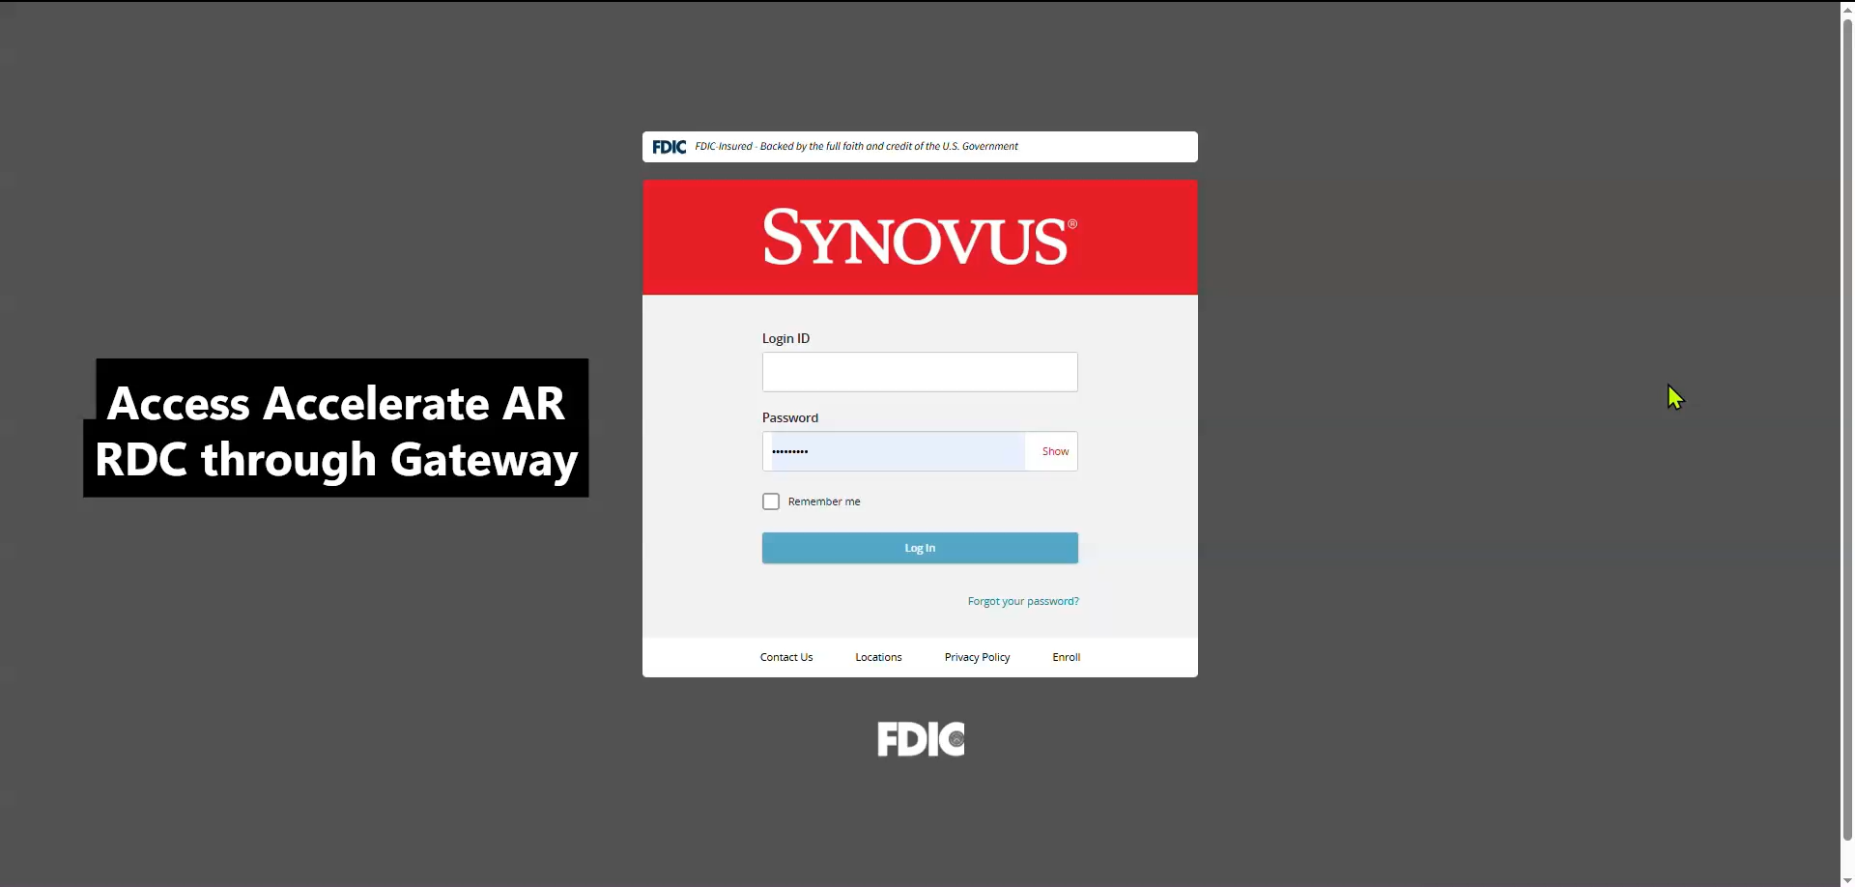
Using Accelerate AR RDC
Click Play for Demo
Congratulations! You’ve successfully installed your Remote Deposit Software and can now begin processing deposits with Accelerate AR RDC.

Slide 11
Questions
?
Contact Your Treasury Management Onboarding Team
or Customer Care Specialists are available for assistance:
Monday through Friday
8 am – 6 pm EST: (888) 796-6887 option Treasury

